Slide 1
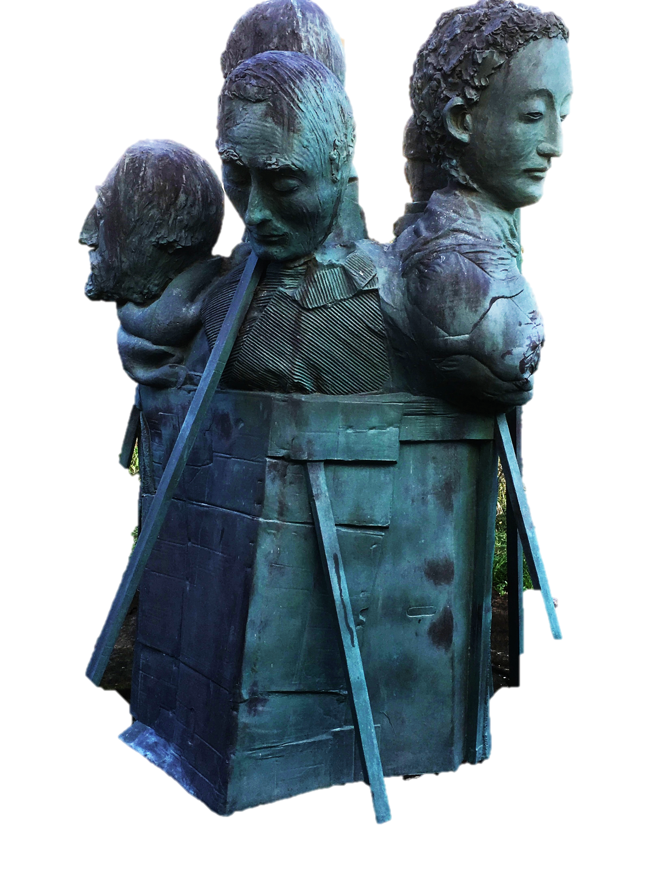
MCOSS2WED
JavaScript: onscroll

Slide 2

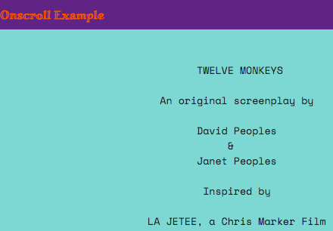
Example
Take a look at this onscroll example:
http://iteachit.net/onscroll/onscroll.html
Try scrolling up and down and note what happens to the top bar.

Slide 3
Overview
This effect can be created using some fairly simple JavaScript.
We are going to be using the onscroll method to change the class of an element.
Changing the class will allow us to change the styling in CSS or even show or hide whole elements.
Onscroll can also be used to trigger almost any other type of action.

Slide 4
Preparation
Create a new HTML file from this template: http://iteachit.net/reference.html
Create a new blank CSS file in a css sub-directory
Create a js sub-directory

Slide 5
Create a header
Add a div with a class of “header” and an ID of “shrink-onscroll” to your body section like this:
<body>
<div class="header" id="shrink-onscroll">
<h1>Onscroll Example</h1>
</div>
</body>
(See onscroll-example1.html)

Slide 6
Create a header
Note that the id of “shrink-onscroll” is important:
<body>
<div class="header" id="shrink-onscroll">
<h1>Onscroll Example</h1>
</div>
</body>
(See onscroll-example1.html)

Slide 7
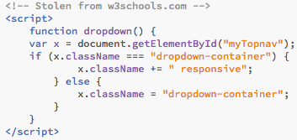
getElementById
We are going to employ the same strategy as in a previous lesson where we built a responsive menu.
Do you remember this? (Don’t type this)

Slide 8
ID & class
We are going to use the same strategy: we are going to change the styling of the header element by changing its class.
The ID will be used in the JavaScript to check which element needs its class changing.
(See onscroll-example1.html)

Slide 9
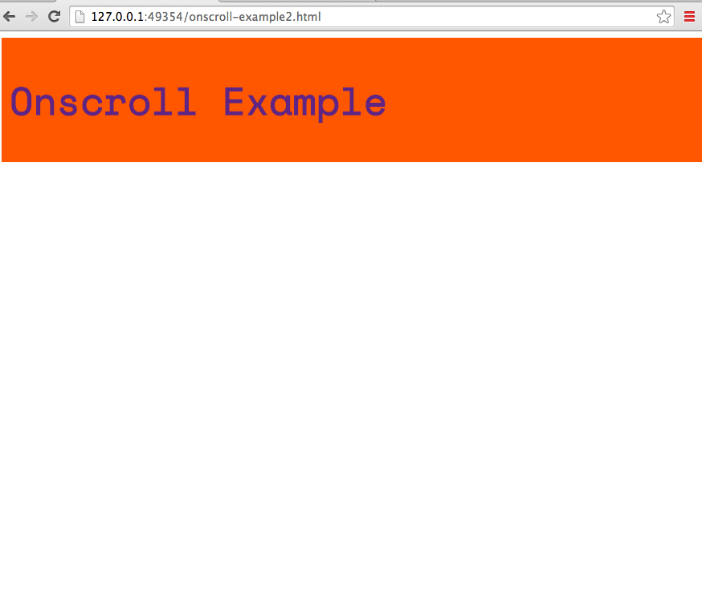
Style your header
Style the header div in your CSS file to be a strip of colour across the browser width.
Change the font and colour as well if you like.
(See onscroll-example2.html & .css)

Slide 10
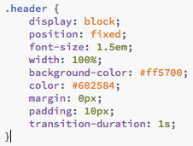
Create a header
The width should be set to 100%.
Set the display, position and font-size as shown below.
The rest of this section of CSS is up to you:
(See onscroll-example2.html & .css)

Slide 11
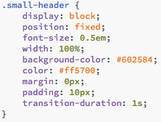
Create a header
Copy the .header style into another section of CSS called .small-header.
Make the font-size much smaller in this new section:
(See onscroll-example3.html & .css)

Slide 12
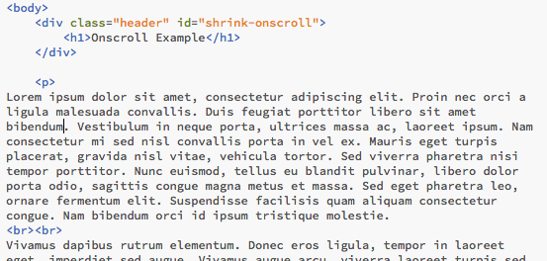
Create content
Now we need some content.
Create a paragraph section in your HTML file with lots of text inside it:
(See onscroll-example4.html & .css)

Slide 13
Add JavaScript
We are going to call our script onscroll.js.
Add this to the bottom of your <head>…</head> section in your HTML file:
<script type="text/javascript" src="js/onscroll.js"></script>

Slide 14
Add JavaScript
Place or type the onscroll.js file into your js directory:
window.onscroll = function() {scrollDetect()};
function scrollDetect() {
if (document.body.scrollTop > 50 || document.documentElement.scrollTop > 50) {
document.getElementById("shrink-onscroll").className = "small-header";
} else {
document.getElementById("shrink-onscroll").className = "header";
}

Slide 15
Add JavaScript
This script runs when the page has been scrolled.
The amount that the page needs to be scrolled before the script changes the class of the appropriate element is set here:
window.onscroll = function() {scrollDetect()};
function scrollDetect() {
if (document.body.scrollTop > 50 || document.documentElement.scrollTop > 50) {
document.getElementById("shrink-onscroll").className = "small-header";
} else {
document.getElementById("shrink-onscroll").className = "header";
}

Slide 16
Add JavaScript
What does this symbol here mean?
window.onscroll = function() {scrollDetect()};
function scrollDetect() {
if (document.body.scrollTop > 50 || document.documentElement.scrollTop > 50) {
document.getElementById("shrink-onscroll").className = "small-header";
} else {
document.getElementById("shrink-onscroll").className = "header";
}

Slide 17
Add JavaScript
This is a logical OR operator.
It means that the script will perform a check and if either of two conditions is true (if the body OR the document element is scrolled is greater that 50 pixels), the highlighted line will run:
window.onscroll = function() {scrollDetect()};
function scrollDetect() {
if (document.body.scrollTop > 50 || document.documentElement.scrollTop > 50) {
document.getElementById("shrink-onscroll").className = "small-header";
} else {
document.getElementById("shrink-onscroll").className = "header";
}

Slide 18
Add JavaScript
Otherwise, this line is executed:
window.onscroll = function() {scrollDetect()};
function scrollDetect() {
if (document.body.scrollTop > 50 || document.documentElement.scrollTop > 50) {
document.getElementById("shrink-onscroll").className = "small-header";
} else {
document.getElementById("shrink-onscroll").className = "header";
}

Slide 19
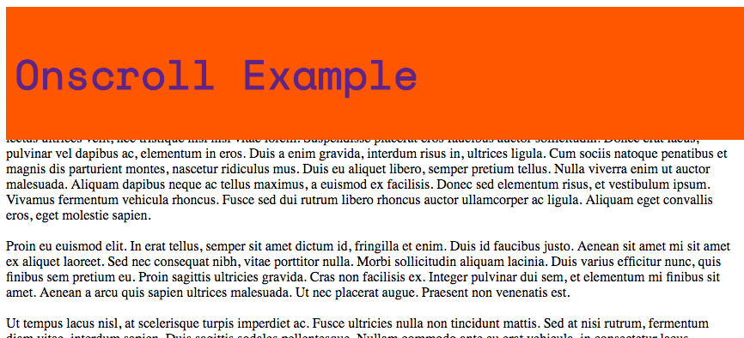
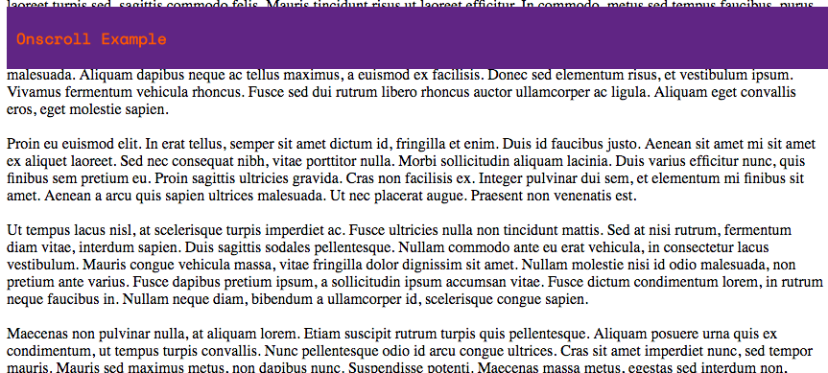
Try it out
Your header should now shrink when you scroll down and grow again when you scroll up (see onscroll-example4.html).
You may need to reduce your browser window height and width or add a lot of content to get this to work smoothly (remember: the script is checking that the page has scrolled more than 50 pixels).

Slide 20
Close the gap
However, there is a gap just above the header…
How can we get rid of this?

Slide 21
Close the gap
To get rid of any gap at the top of the page, try reducing the body and paragraph top margin to zero:
p {
margin-top: 0px;
}
body {
margin-top: 0px;
}
(See onscroll-example5.html & .css)

Slide 22
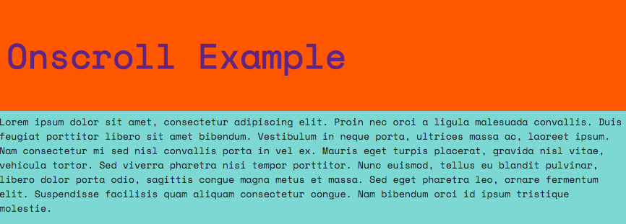
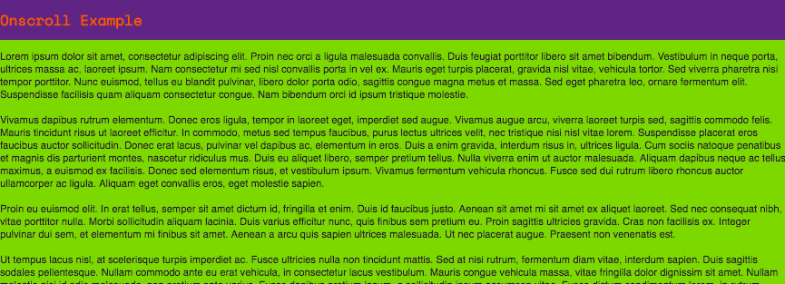
Challenge 1
Can you add code to your JavaScript and CSS to change the paragraph element as well as the header div when you scroll your page?
Change these properties:
Paragraph font family
Paragraph font size
Paragraph background colour

Slide 23

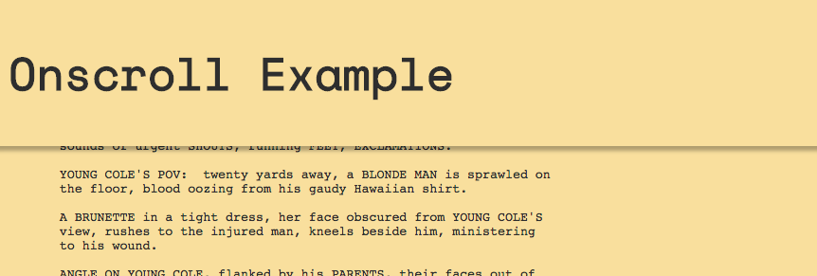
Challenge 2
Can you change your header and content element to look like a flat single colour by default and then add a shadow to the header when you scroll your page 5 or more pixels?

Slide 24
Summary
The JavaScript will run when the page is scrolled ANY amount (triggered by the window.onscroll detection).
If the page top is more than 50 pixels above the browser window, the element with ID shrink-onscroll will have its class changed to “small-header”.
If the page top is less than 50 pixels above the browser window, the element with ID shrink-onscroll will have its class changed to “header”.
window.onscroll = function() {scrollDetect()};
function scrollDetect() {
if (document.body.scrollTop > 50 || document.documentElement.scrollTop > 50) {
document.getElementById("shrink-onscroll").className = "small-header";
} else {
document.getElementById("shrink-onscroll").className = "header";
}

